Slide 1



SCIANTIX «Past»
SCIANTIX Present
SCIANTIX Future
Challenges
Davide Pizzocri
Lyon and online, 15.05.2024

Slide 2
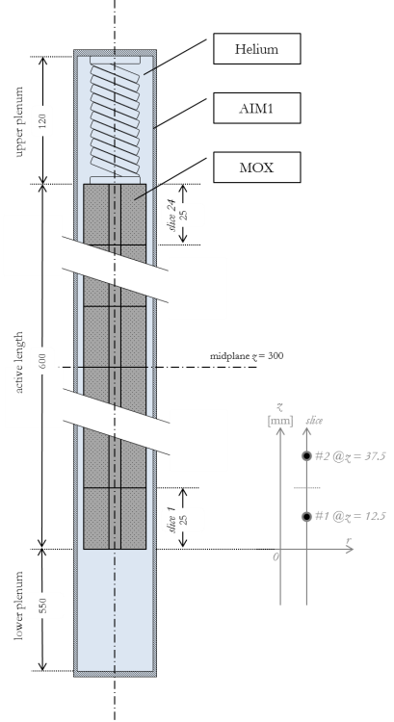
Object, nuclear fuel pin
Helium gap
Nuclear fuel rod (ThR//FR) is made of a stack of oxide (UO₂//MOX) fuel pellets wrapped in metallic (Zry//SS) cladding
Its performance is fundamental for safe operation of the reactor (and licensing and design)
Need of integral fuel performance codes (FPCs) and integral irradiation experiments to assess the fuel rod thermo-mechanical behaviour (σ,ε, and T)
Focus on inert gas behavior, i.e.,
gaseous swelling & fission gas release
Cladding
Fuel

Slide 3
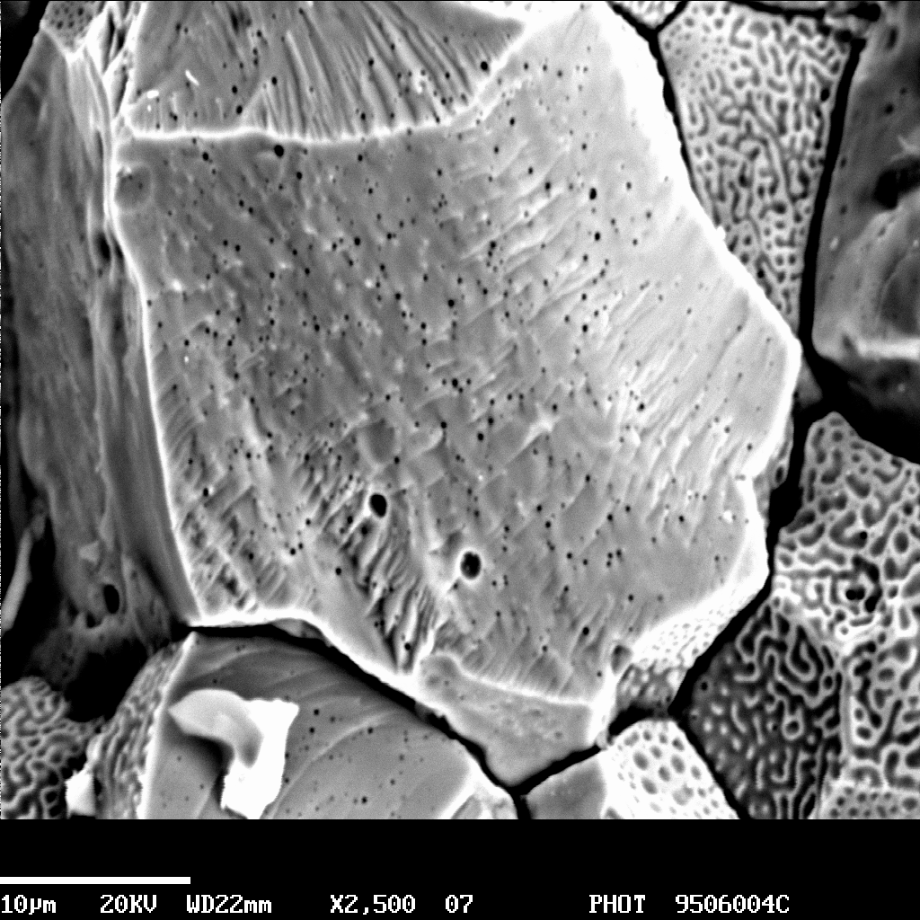

OperaHPC
TRANSPARANT
Horizon Europe (2023-2027, 300k€)
WP leadership (V&V)
Involved in code development, V&V, UA&SA, ML
Obj Developement of open source tools for nuclear fuel simulation
Ongoing activities
Data assimilation / ANN
Qualification standards
Integral validation
Horizon Europe (2024-2028, 400k€)
WP leadership (code development)
Involved in support to experimental design, code development, …
Obj Development of actinide bearing fuels and technologies
Planned activities
Thermochemistry
Material properties
Radioactive fission products

Slide 4
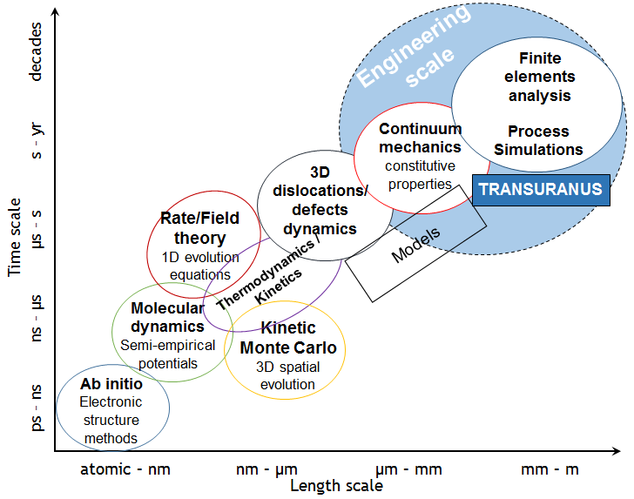
Multi-scale modelling approach
SCIANTIX. Grain-scale code, for model development and V&V
Goal. Simulation of integral experiments (IFPE) at engineering//reactor-scale
Goal. Modelling at grain-scale and assessment (by separate effect experiments)
Next talks
M. Bertolus
A. Scolaro

Slide 5
Multi-scale modelling approach, requirements
Physics-based modelling is fundamental in order to act as bridge between different scales
Can be informed by lower-length scale calculations and experiments, in terms of physical phenomena and model parameters
Need to overcome correlation-based approaches currently used in FPCs
Low computational time is needed for effective use within fuel performance codes
IGB model called at each thermo-mechanical iteration, in each time-step of the FPC simulation, in each mesh point
The huge number of calls implies that numerical robustness is a requirement
BISON
Helium gap
Cladding
Fuel

Slide 6


Multi-scale modelling approach, requirements
Developed at Politecnico di Milano
It is a 0D stand-alone code, designed to be included as a mechanistic fission gas behaviour module in existing fuel performance codes
Constitutes the natural environment for the development, verification, and validation of fission gas behaviour models, and for the simulation of separate-effect test experiments
It can be included in existing multiphysics platforms and fuel performance codes as a module (via simple interface) to evaluate fission gas release and gaseous swelling or can be used as stand-alone
Available as open-source software (MIT license)

Slide 7
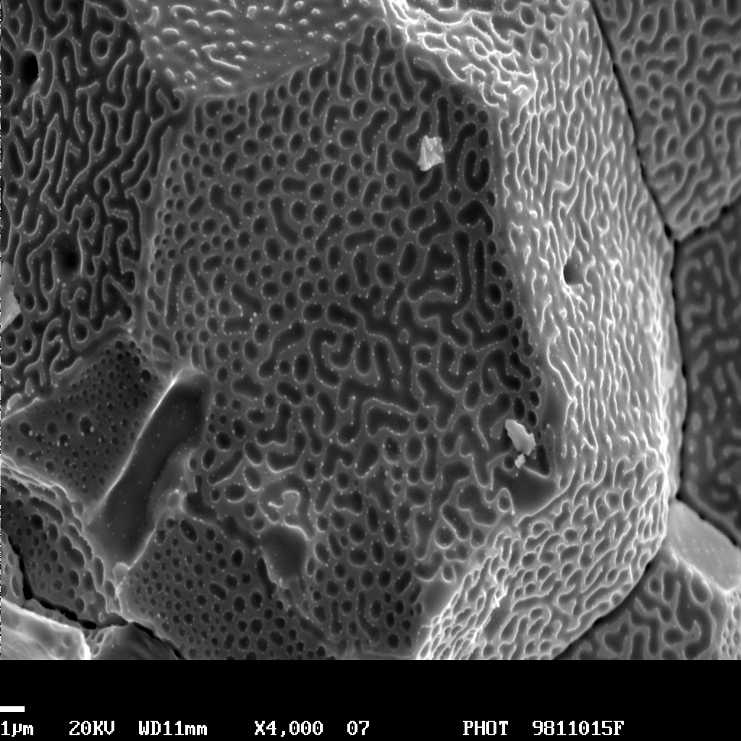
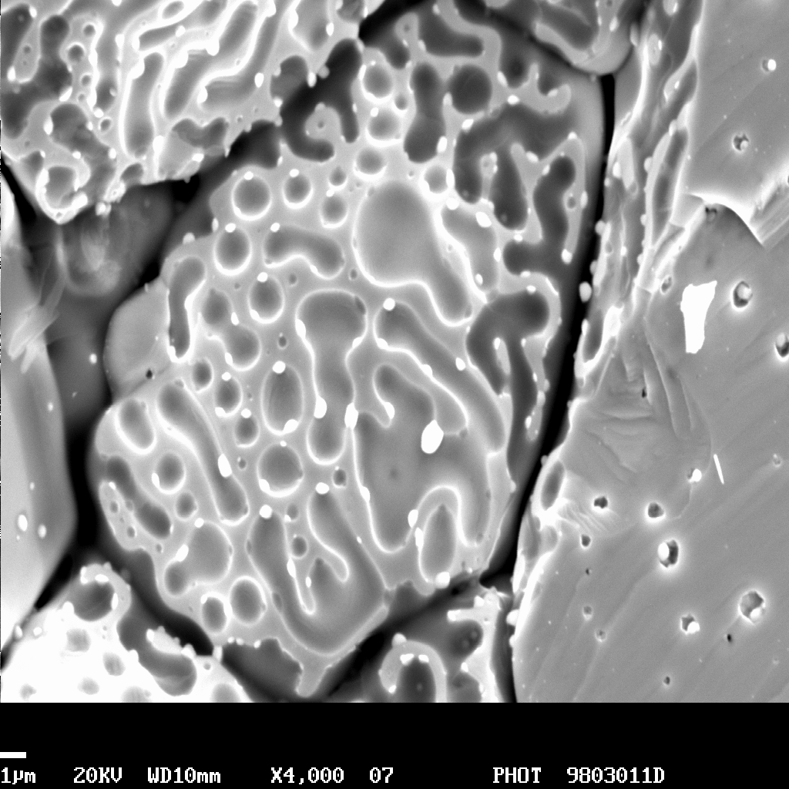
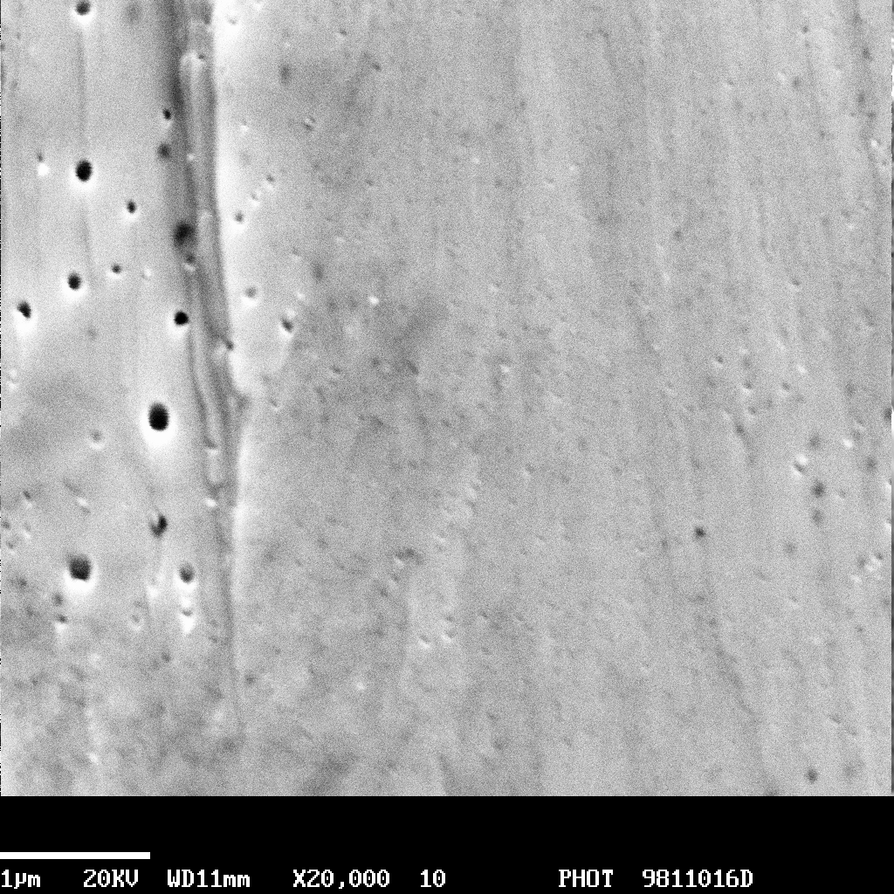
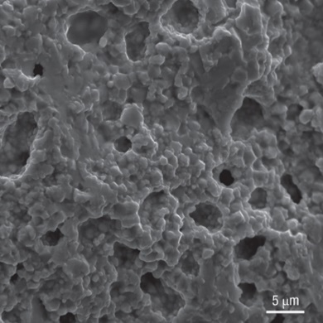
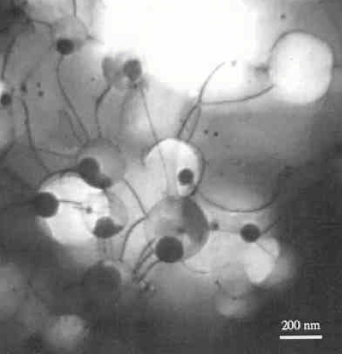
The SCIANTIX code, physical aspects
Fission reactions
Generation of fission gases (Xe, Kr)
Intra-granular gas (single atoms)
Diffusion
Trapping
Inter-granular gas
(lenticular bubbles)
Intra-granular gas
(small & coarsened bubbles)
Re-solution
Grain-boundary saturation and/or micro-cracking
Inter-granular bubble swelling
Intra-granular bubble swelling
Fission
gas release
High burnup structure

Slide 8
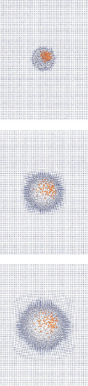
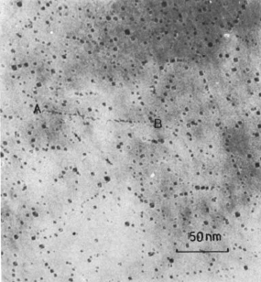
State of the Art. Correlations for bubble radius and bubble concentration, f(T)
Applicative modelling example
Intra-granular bubble evolution
Lower length-scale information available
Bubble nucleation appears to be driven by fission fragments
Bubble re-solution appears to be (mainly) heterogeneous and again driven by fission fragments
Baker, J. Nucl. Mater., 1977
2 nm
0.1 ps
0.5 ps
1.0 ps
Govers et al., J. Nucl. Mater., 2012

Slide 9
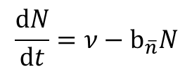
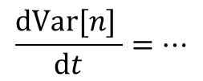
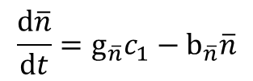
Applicative modelling example
Intra-granular bubble evolution
Physically-based single-size model derived from cluster dynamics
Fokker-Planck expansion in the phase space, at order zero
Assumption of first moment expansion implies single-size model and is valid for peaked distributions (confirmed from LLS)
All clusters with size n > 2 are considered immobile and counted as bubbles
$$\frac{dN}{dt}=ν−b_{\overline{n}}N$$
$$\frac{d\overline{n}}{dt}=g_{\overline{n}}c_{1}−b_{\overline{n}}\overline{n}$$
$$\frac{dVar[n] }{dt}=…$$

Slide 10
Applicative modelling example
Intra-granular bubble evolution, separate effect validation
Data from Baker, 1977. JNM
Separate effect validation performed in SCIANTIX: good agreement with experimental data
UA & SA with respect to model parameters via Total Monte Carlo (low computational time)

Slide 11
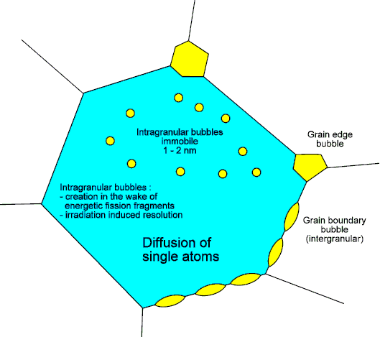
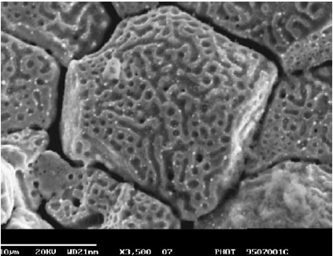
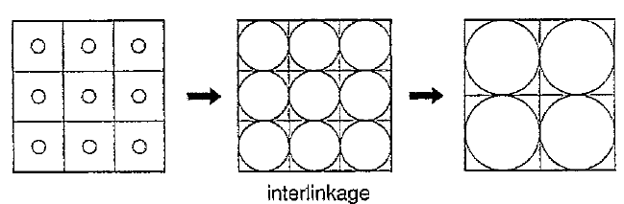
Inter-granular bubble evolution
Pastore et al., 2013, NED
Grain-boundary bubbles growth by vacancy absorption and coalescence
A saturation value of the fractional coverage of the grain-faces is considered
At saturation, further bubble growth
is compensated by gas release
+ Grain-boundary micro-cracking
F_{c} increases
F_{c} = constant (FGR occurs)
Saturation

Slide 12
Inter-granular bubble evolution, separate effect validation
White et al., 2006

Slide 13
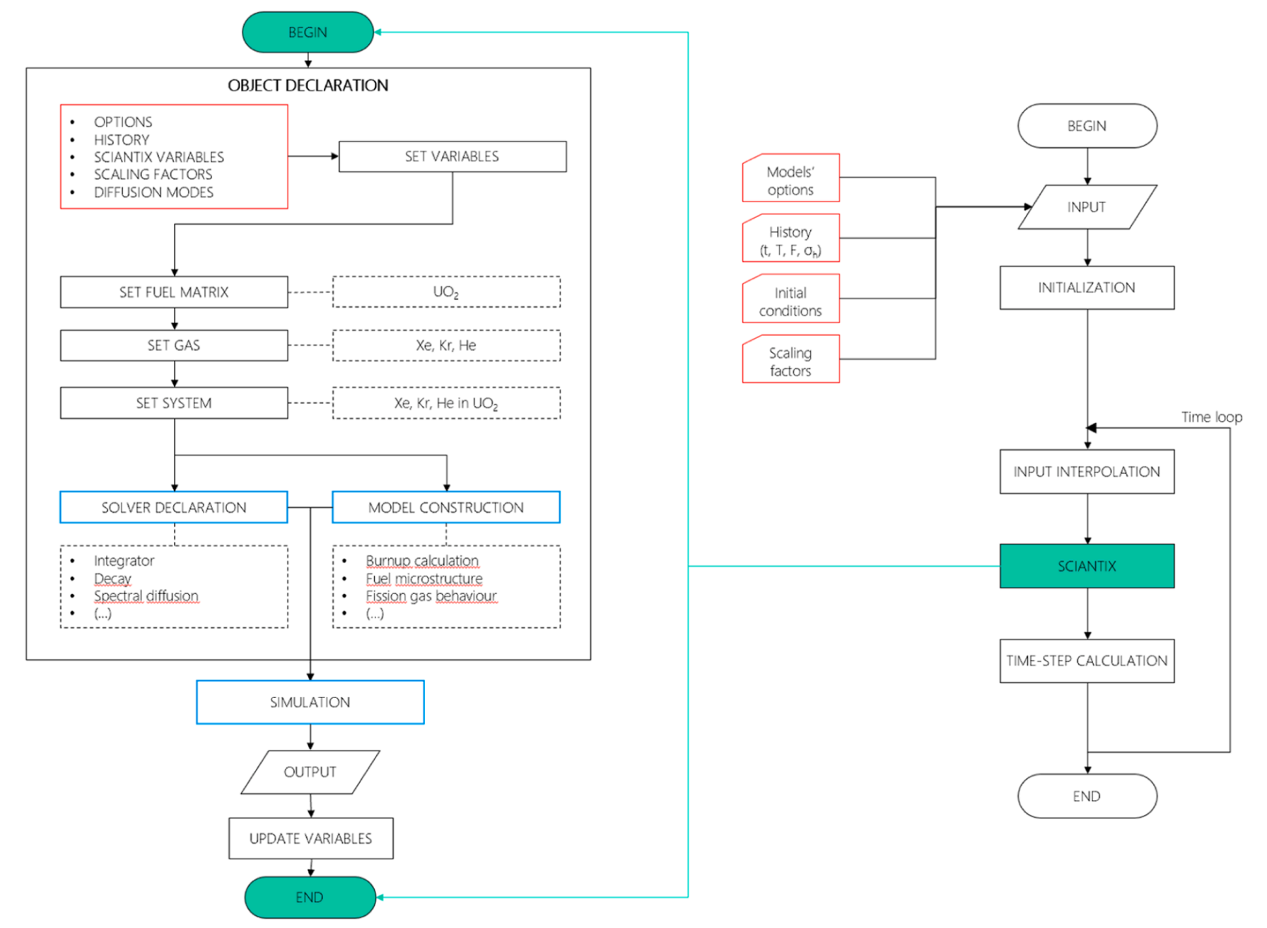
The SCIANTIX 2.0 flowchart
External shell (right) representing the coupling with fuel performance codes (TRANSURANUS, OFFBEAT, …)
Meso-scale module (left) containing physical / behavioural models
construction of specific objects for IGB modelling
definition of solvers (robust numerics)
simulation = models + solvers
V&V continuous activities, matrix of cases for non-regression tests

Slide 14
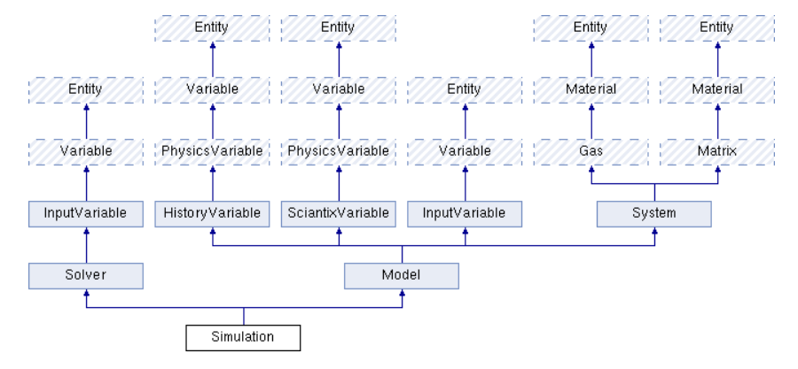
The SCIANTIX 2.0 inheritance diagram

Slide 15

The SCIANTIX 2.0 inheritance diagram
Helium
in UO₂ / MOX
Helium behaviour
Production
Diffusion
Solubility
Interaction with fission gases → bubbles

Slide 16
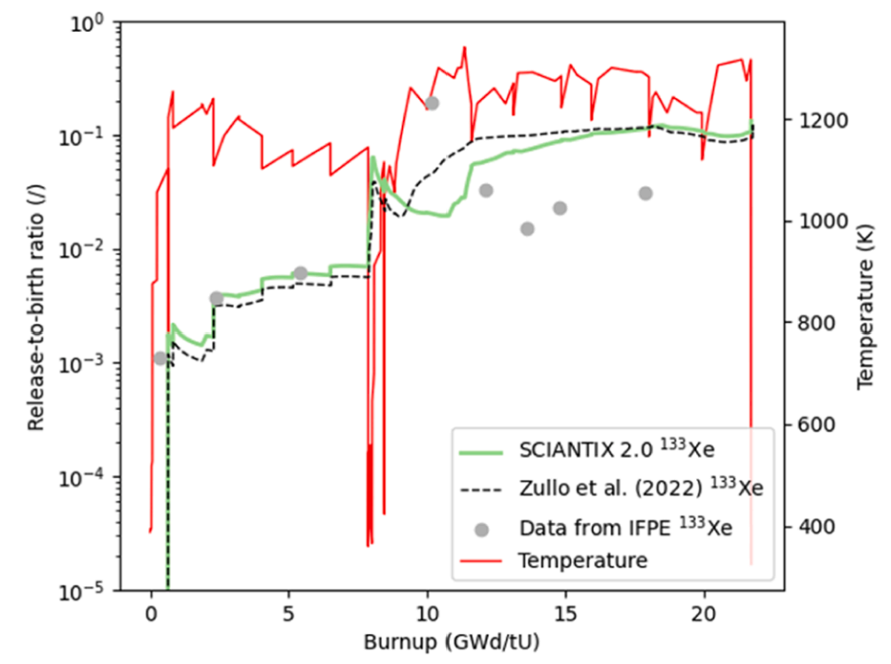

The SCIANTIX 2.0 inheritance diagram
Cs, I, Te, … in …
CsI, … in …
Interaction with thermochemistry module
Useful for experimental design (source term estimation)
Step towards JOG models

Slide 17

The SCIANTIX 2.0 inheritance diagram
Connected to fuel microstructure (e.g., High Burnup Structure)
Connection to material properties
Use of advanced modelling techniques (surrogate modelling)

Slide 18
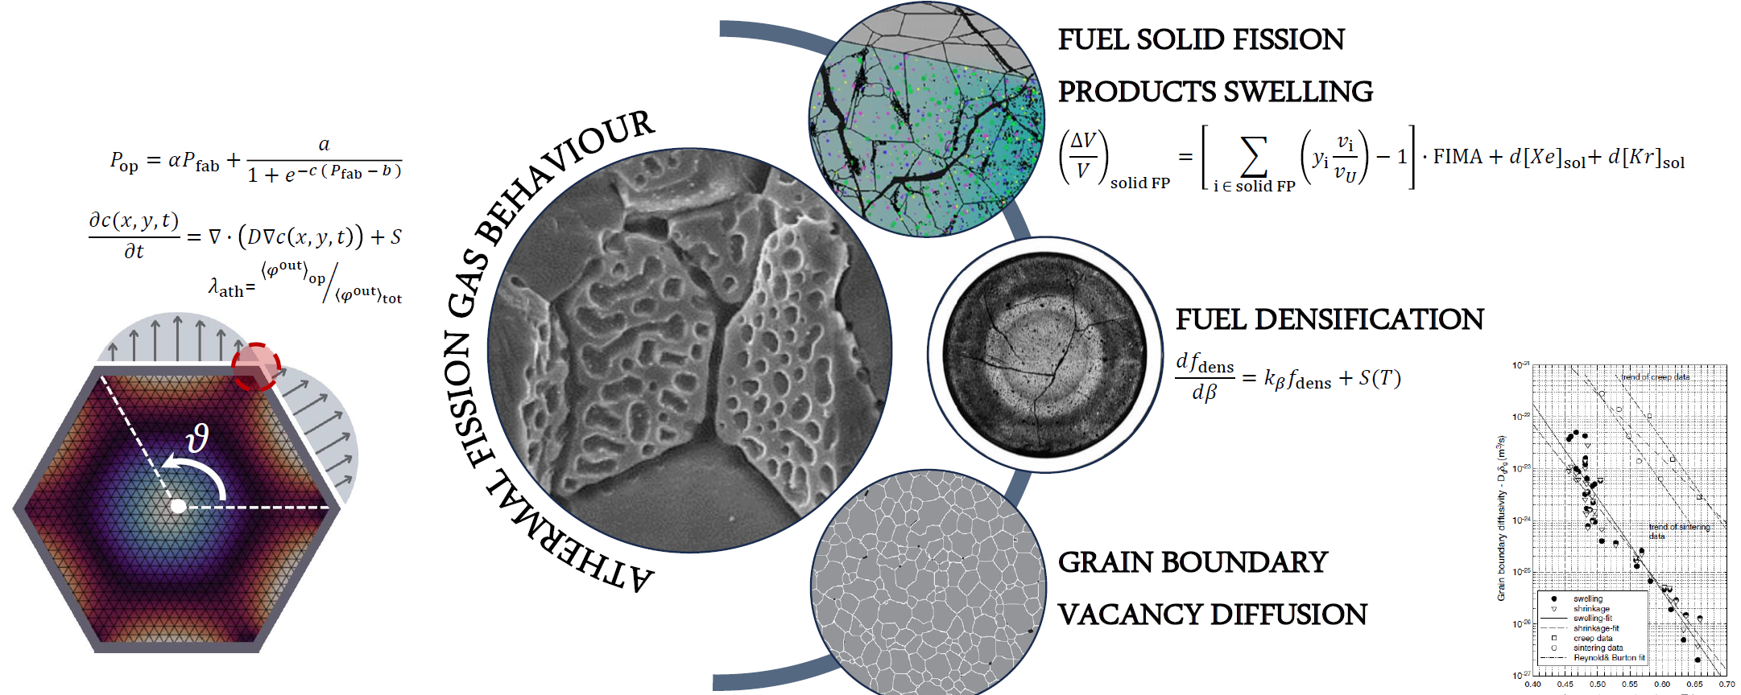
Ongoing model development
Athermal release

Slide 19
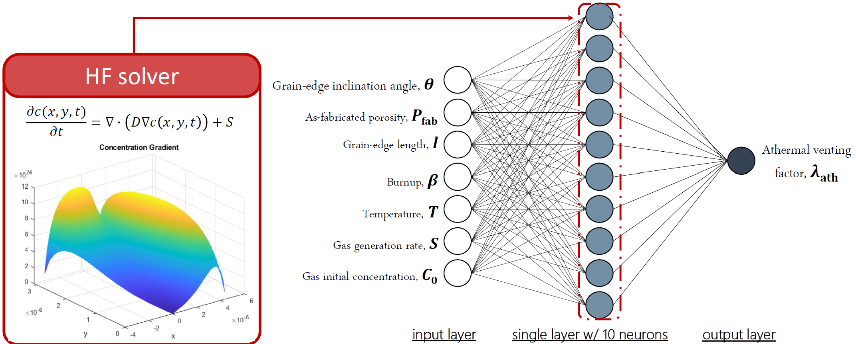
Ongoing model development
Athermal release

Slide 20
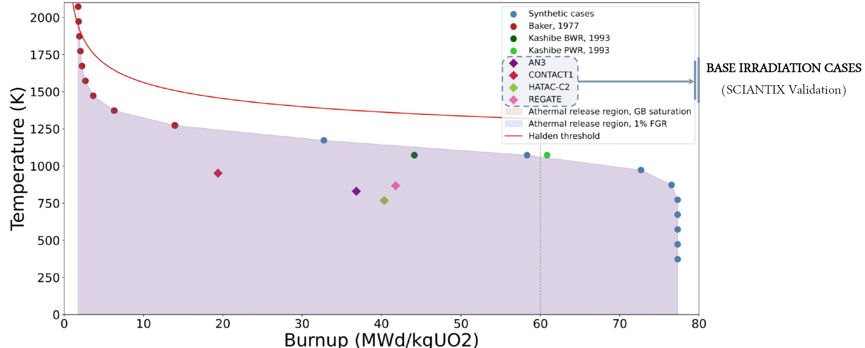
Ongoing model development
Athermal release

Slide 21
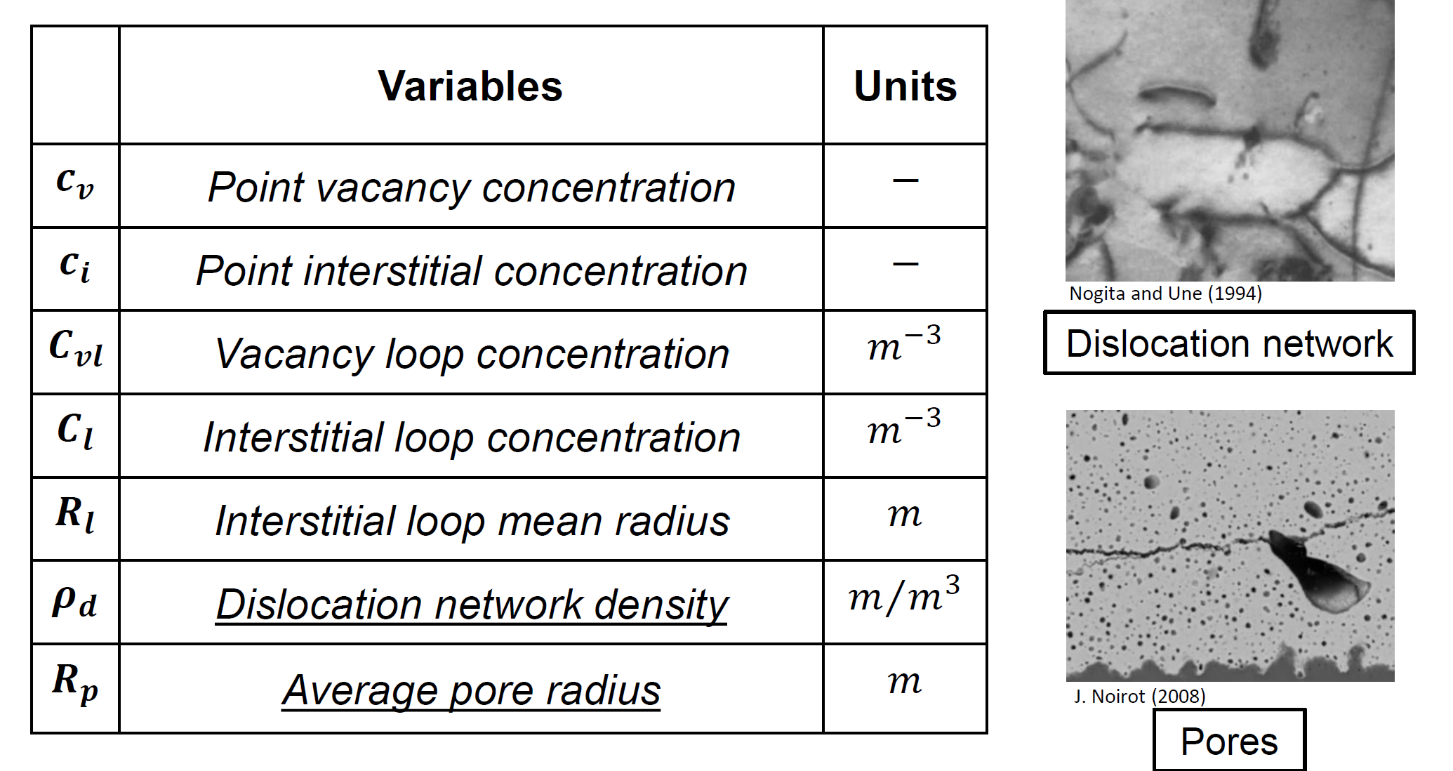
Ongoing model development
Dislocation density

Slide 22
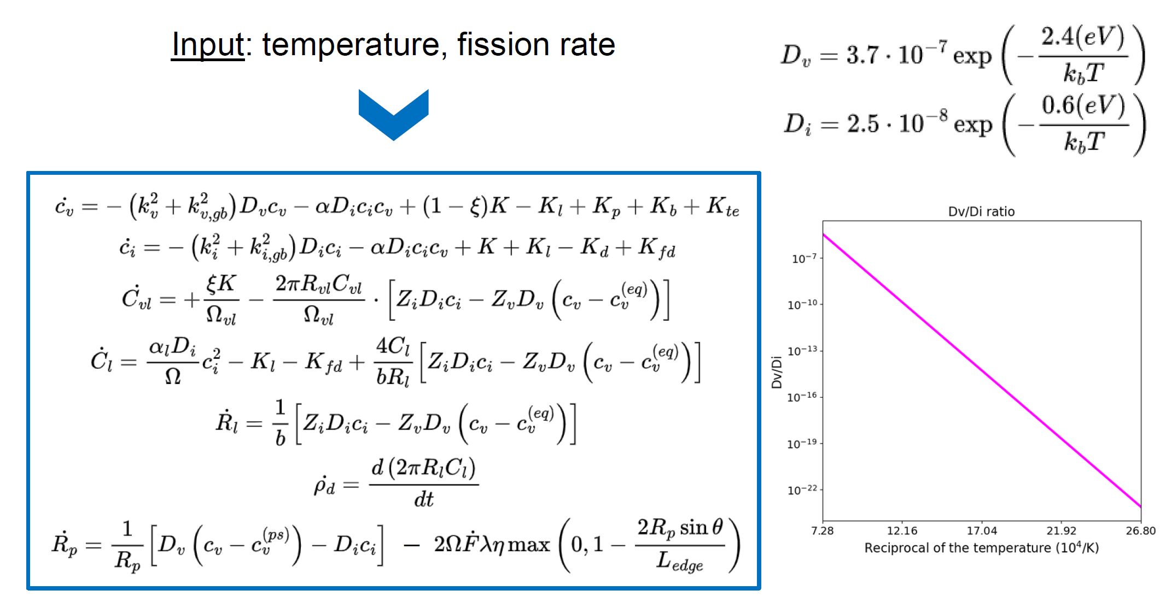
Ongoing model development
Dislocation density

Slide 23
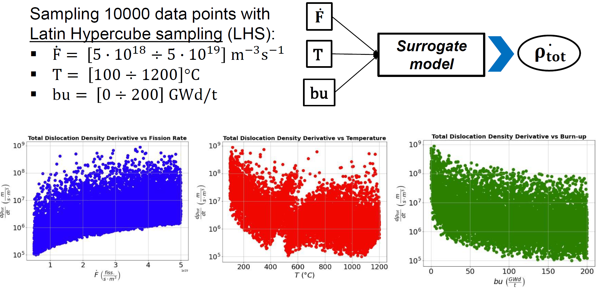
Ongoing model development
Dislocation density, surrogate model

Slide 24
Conclusion and Future challenges
As models become more and more physics-based and accurate in representing the phenomena of interest, the computational requirements rises
Room for applying machine learning and artificial intelligence methodologies
Challenge of explainability of such methods
As SCIANTIX use is more and more relevant in engineering calculation, the quality assurance of the code becomes a priority
Activities ongoing in the OperaHPC project and in other international frameworks
Effort in involving in the team non-nuclear profiles
As the framework for research activities on nuclear material changes (e.g., CONNECT-NM) thekey features of SCIANTIX can open up opportunities
Accelerated qualification of nuclear fuels (fast transfer of knowledge along scales)
Extension to other nuclear materials

Slide 25
Thank you all for your kind attention !

Slide 26
Exchanges
Self-introduction
Contributions from new users
New development of interest
Intention for future proposals
Davide Pizzocri, Lelio Luzzi
Lyon and online, 15.05.2024

Slide 27
Summary
SCIANTIX is at a sweet spot in the multi-scale modelling and calculation chain
The inclusion of SCIANTIX in fuel performance codes is fairly easy (depending on the targeted application)
The transfer of info/data from lower-length scales is direct
FPCs
FPCs
Meso-scale
Separate effect
Lower-length scales

Slide 28
Summary
SCIANTIX is a meso-scale tool originally developed for the simulation of inert gas behaviour in oxide fuels
It has a flexible structure and can be extended towards other fission products and other fuel materials
Each model in SCIANTIX is validated based on separate effect tests
Athermal release
→ SMRs, DH
Helium
→ FRs, storage
Doped fuels
→ ATF, SMRs
???
Dislocation density
→ SMRs, DH
Fuel fragmentation
→ Accidental conditions
Fission product behaviour → JOG
Other materials ???

Slide 29
Conclusion and Future challenges
As models become more and more physics-based and accurate in representing the phenomena of interest, the computational requirements rises
Room for applying machine learning and artificial intelligence methodologies
Challenge of explainability of such methods
As SCIANTIX use is more and more relevant in engineering calculation, the quality assurance of the code becomes a priority
Activities ongoing in the OperaHPC project and in other international frameworks
Effort in involving in the team non-nuclear profiles
As the framework for research activities on nuclear material changes (e.g., CONNECT-NM) thekey features of SCIANTIX can open up opportunities
Accelerated qualification of nuclear fuels (fast transfer of knowledge along scales)
Extension to other nuclear materials

